Slide 2
If we are in difficult times and if people are becoming progressively worse, how should we respond?

Slide 3
This is what we are commanded to do:
Notes:
I know that this is “Family month”, but I felt led to continue with the last days for a few reasons:
Because our children are being confronted with the behavior of people in the last days
Because our marriages are breaking up due to selfishness, pride, etc.

Slide 4
Eph 5:8 - For you were once darkness, but now you are light in the Lord. Walk as children of light
Notes:
I know that this is “Family month”, but I felt led to continue with the last days for a few reasons:
Because our children are being confronted with the behavior of people in the last days
Because our marriages are breaking up due to selfishness, pride, etc.

Slide 5
Walk as children of light!
The word “walk” here is used to describe the way in which we live or behave.
It speaks of the direction that we move, the way that we should go

Slide 6
I want to show you three things:
What should we be like?
What should we not be like?
How can we become what God wants us to be?

Slide 7
What should we be like?
Notes:
I know that this is “Family month”, but I felt led to continue with the last days for a few reasons:
Because our children are being confronted with the behavior of people in the last days
Because our marriages are breaking up due to selfishness, pride, etc.

Slide 8
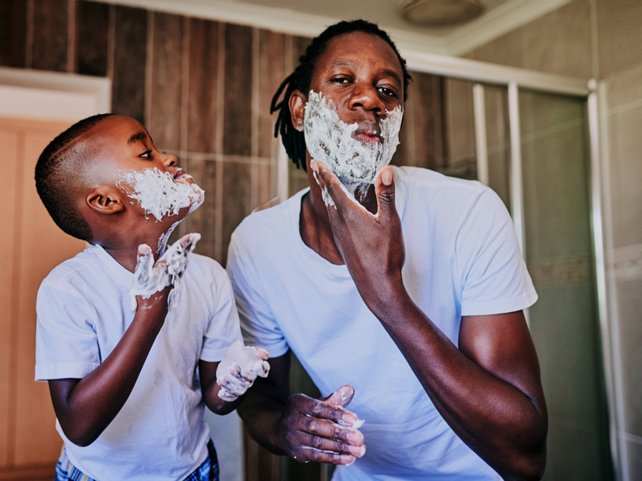
We should imitate God, the way a child would imitate their father:
Notes:
I know that this is “Family month”, but I felt led to continue with the last days for a few reasons:
Because our children are being confronted with the behavior of people in the last days
Because our marriages are breaking up due to selfishness, pride, etc.

Slide 9
Eph 5:1 - Therefore be imitators of God as dear children.

Slide 10
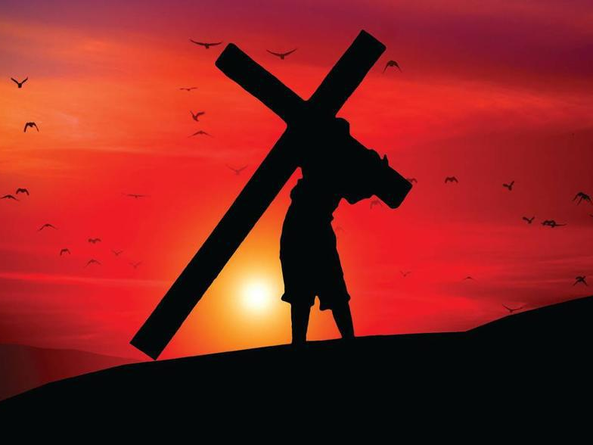
Walk in love, by giving ourselves to others the way that Jesus did.

Slide 11
Eph 5:2 - And walk in love, as Christ also has loved us and given Himself for us, an offering and a sacrifice to God for a sweet-smelling aroma.

Slide 12
What should we not be like?
Notes:
I know that this is “Family month”, but I felt led to continue with the last days for a few reasons:
Because our children are being confronted with the behavior of people in the last days
Because our marriages are breaking up due to selfishness, pride, etc.

Slide 13
We must not follow the pattern of those who do not know God:

Slide 14
Eph 5:3 - But fornication and all uncleanness or covetousness, let it not even be named among you, as is fitting for saints;

Slide 15
Eph 5:4 - neither filthiness, nor foolish talking, nor coarse jesting, which are not fitting, but rather giving of thanks.

Slide 16
A closer look:
Fornication (sexual immorality)
Uncleanness (impurity, lust)
Covetousness (greed)
Filthiness (obscenity, indecency,)
Foolish talking (silly and corrupt, words said in sport)
Coarse jesting (similar to making fun of people in a hurtful way)

Slide 17
This type of lifestyle has a very serious penalty:

Slide 18
Eph 5:5 - For this you know, that no fornicator, unclean person, nor covetous man, who is an idolater, has any inheritance in the kingdom of Christ and God.

Slide 19
Eph 5:6 - Let no one deceive you with empty words, for because of these things the wrath of God comes upon the sons of disobedience.

Slide 20
Don’t do what they do:
Notes:
I know that this is “Family month”, but I felt led to continue with the last days for a few reasons:
Because our children are being confronted with the behavior of people in the last days
Because our marriages are breaking up due to selfishness, pride, etc.

Slide 21
Eph 5:7 - Therefore do not be partakers with them.

Slide 22
Eph 5:8 - For you were once darkness, but now you are light in the Lord. Walk as children of light

Slide 23
Eph 5:9 - (for the fruit of the Spirit is in all goodness, righteousness, and truth),

Slide 24
Eph 5:10 - finding out what is acceptable to the Lord.

Slide 25
Eph 5:11 - And have no fellowship with the unfruitful works of darkness, but rather expose them.

Slide 26
Eph 5:12 - For it is shameful even to speak of those things which are done by them in secret.

Slide 27
Eph 5:13 - But all things that are exposed are made manifest by the light, for whatever makes manifest is light.

Slide 28
Eph 5:14 - Therefore He says: "Awake, you who sleep, Arise from the dead, And Christ will give you light."

Slide 29
But how can we live a righteous life?
Notes:
I know that this is “Family month”, but I felt led to continue with the last days for a few reasons:
Because our children are being confronted with the behavior of people in the last days
Because our marriages are breaking up due to selfishness, pride, etc.

Slide 30
By the Holy Spirit!
Notes:
I know that this is “Family month”, but I felt led to continue with the last days for a few reasons:
Because our children are being confronted with the behavior of people in the last days
Because our marriages are breaking up due to selfishness, pride, etc.

Slide 31
Eph 5:15 - See then that you walk circumspectly, not as fools but as wise,

Slide 32
Eph 5:16 - redeeming the time, because the days are evil.

Slide 33
Eph 5:17 - Therefore do not be unwise, but understand what the will of the Lord is.

Slide 34
Eph 5:18 - And do not be drunk with wine, in which is dissipation; but be filled with the Spirit,

Slide 35
Eph 5:19 - speaking to one another in psalms and hymns and spiritual songs, singing and making melody in your heart to the Lord,

Slide 36
Eph 5:20 - giving thanks always for all things to God the Father in the name of our Lord Jesus Christ,

Slide 37
Eph 5:21 - submitting to one another in the fear of God.

Slide 38
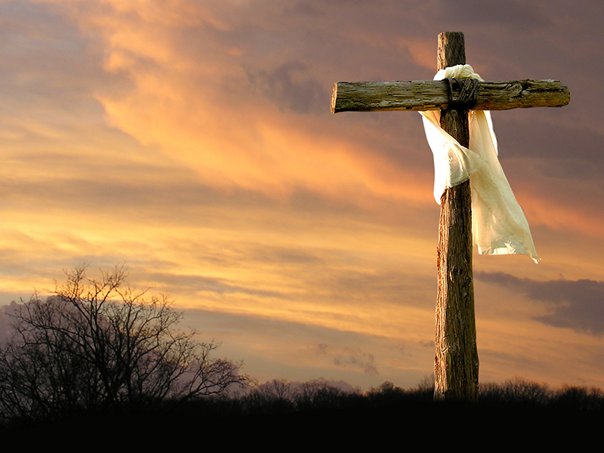
What is God saying to us?
We are the salt of the earth, the light of the world
We have been chosen to live differently from those who do not know God
We can do this, through the power of the Holy Spirit. Ask God to fill you with His Spirit!

